Slide 1

Task 2: Hotel Reservation Analysis With SQL
Name: Rahul Dinkar Deshmukh
Profile: Data Analyst Intern
Batch: MIP-DA-04

Slide 2

Project Overview :
The hotel industry relies on data to make informed decisions and provide a better guest experience.
Tasked as a data analyst, the objective is to analyze a hotel reservation data set for valuable insights.
Through Thorough analysis, we aim to uncover patterns and trends to understand guest preferences, booking trends and key factors that impact the hotel’s operations.
Contribute to informed decision-making and enhance guest experience through data analysis.

Slide 3
Dataset Description
Description of each column in the dataset (Hotel Reservation Dataset)
Booking_ID: A unique identifier for each hotel reservation.
no_of_adults: The number of adults in the reservation.
no_of_children: The number of children in the reservation.
no_of_weekend_nights: The number of nights in the reservation that fall on weekends.
no_of_week_nights: The number of nights in the reservation that fall on weekdays.
type_of_meal_plan: The meal plan chosen by the guests.
room_type_reserved: The type of room reserved by the guests.
lead_time: The number of days between booking and arrival.
arrival_date: The date of arrival.
market_segment_type: The market segment to which the reservation belongs.
avg_price_per_room: The average price per room in the reservation.
booking_status: The status of the booking.

Slide 4
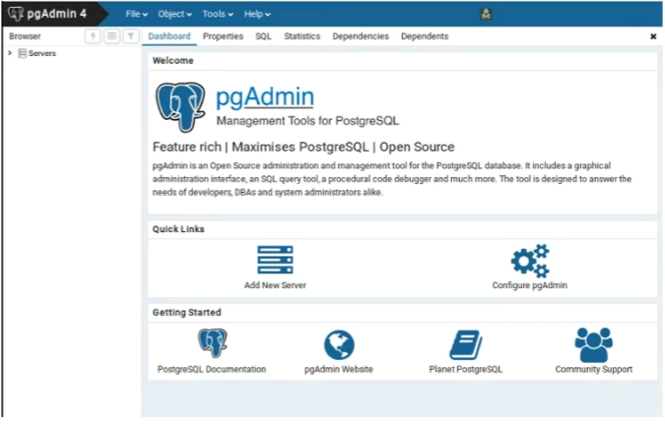

DBMS and Tool Used
Database Management System Used
Management Tool: pgAdmin 4

Slide 5
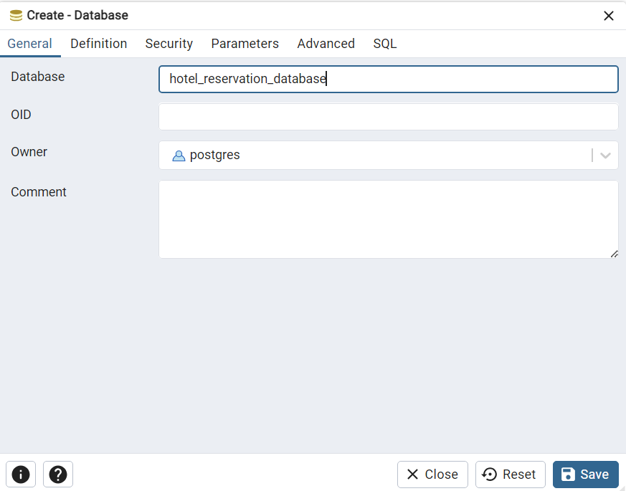
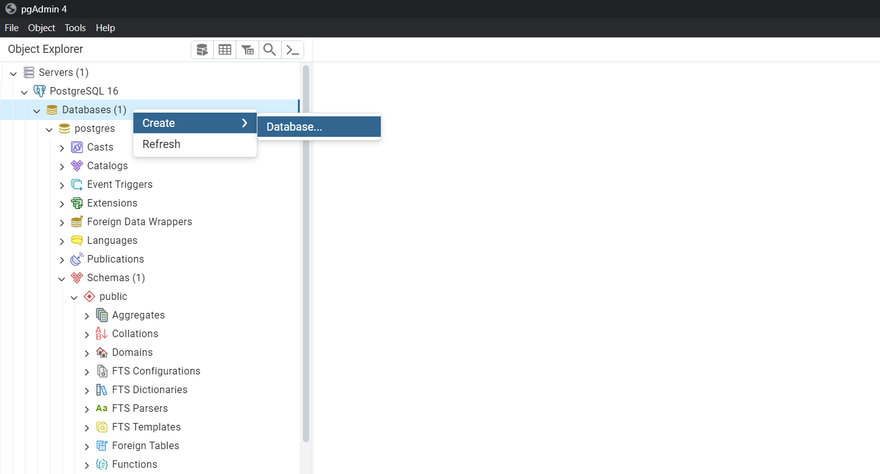
Creating Database
“hotel_reservation”_database

Slide 6
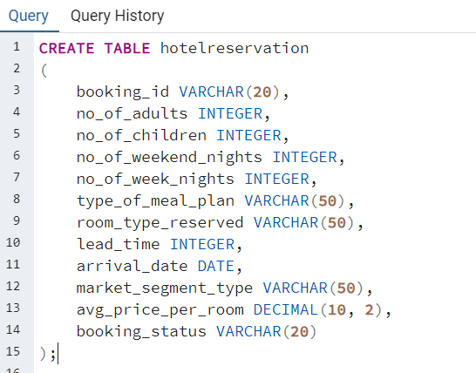
Creating Table
Query to Create the Table

Slide 7
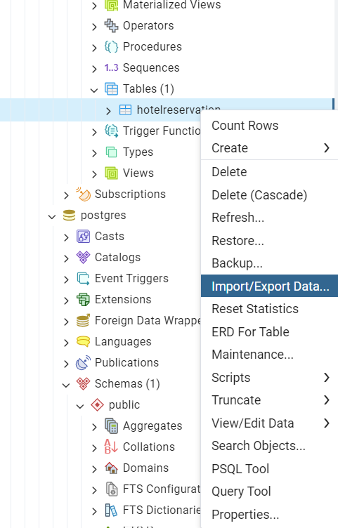
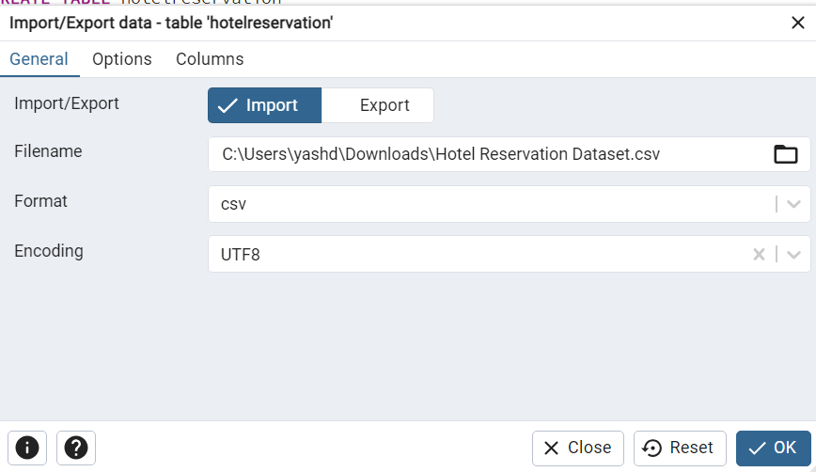
How to Import Data into Table?
Left click on hotelreservation & Select
“Import/Export Data”
Select the path which leads to “Hotel Reservation Dataset.csv” file

Slide 8
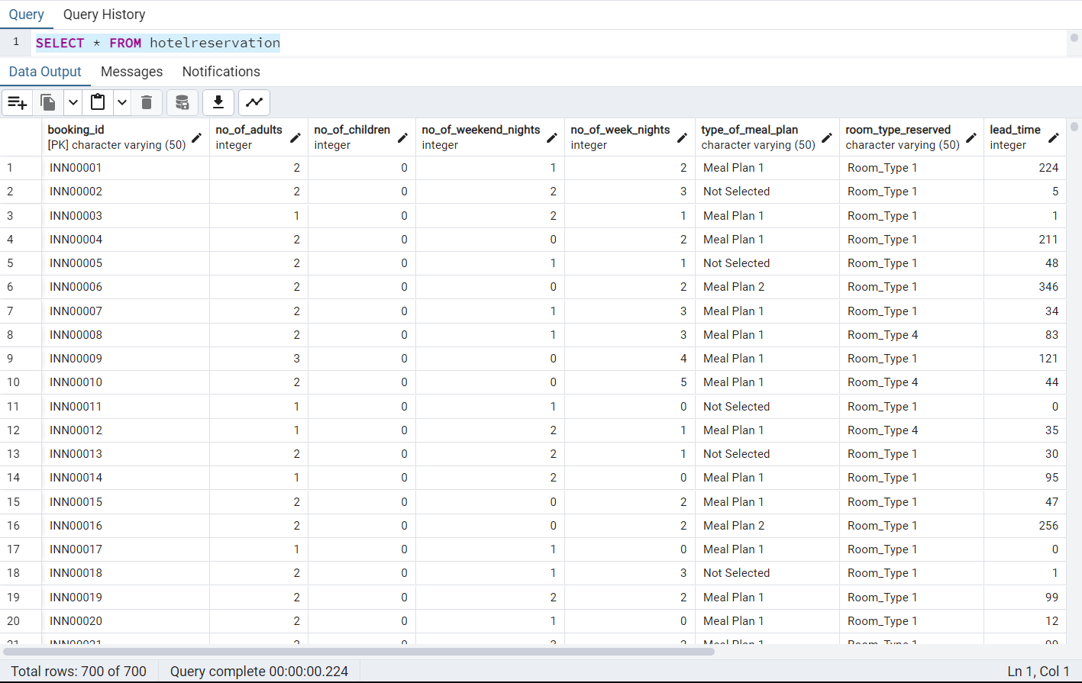
Imported Data Into Table
SELECT – SELECT statement used to fetch the data.
FROM – Used to from which table we want to fetch data.

Slide 9
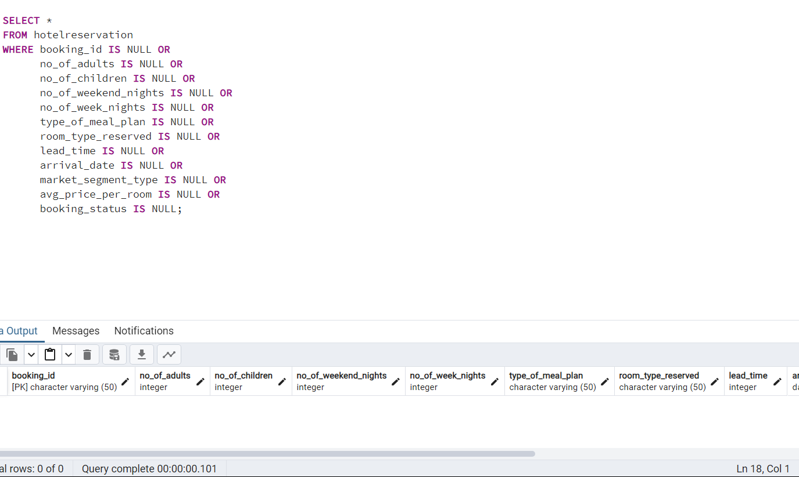
Data Cleaning
To avoid any errors, we check for missing value / null value
Write a code to check NULL values
SQL Query
Output

Slide 10
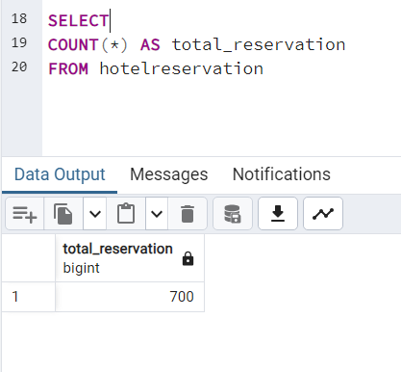
What is the total number of reservations in the dataset?
The total number of reservations in the database is 700

Slide 11
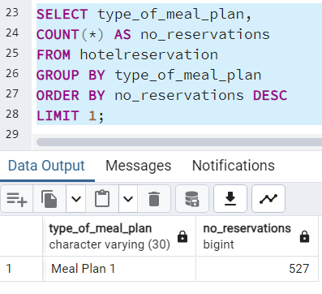
Which meal plan is the most popular among guests?
Meal Plan is the most popular amoung ths guest is the “Meal_plan 1” type_of_meal_plan is popular.

Slide 12
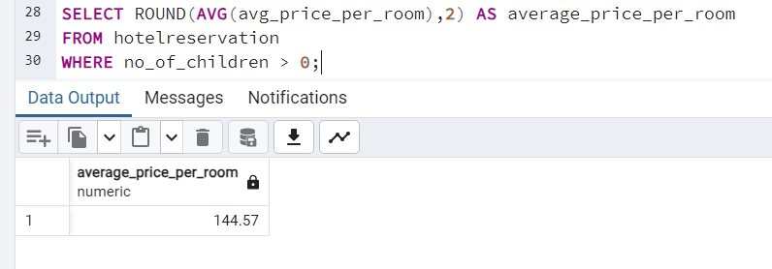
What is the average price per room for reservations involving children?
The Average price per room for reservation involving children is 144.57 Rs.

Slide 13
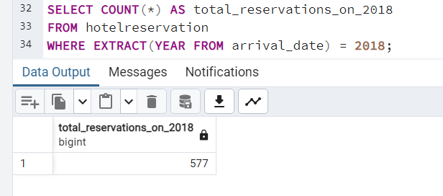
How many reservations were made for the year 20XX (replace XX with the desired year)?
577 reservations were made for the year 2018 ( we replaced XX with 18 for the desired year )

Slide 14
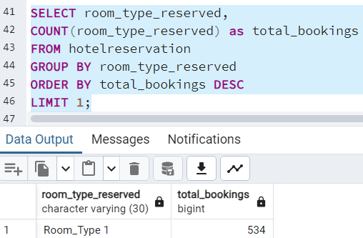
What is the most commonly booked room type?
The most commonly booked room type is Room_type 1.

Slide 15
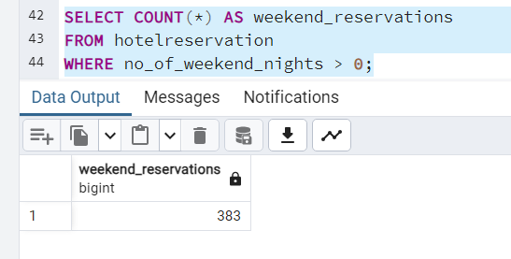
How many reservations fall on a weekend (no_of_weekend_nights > 0)?
383 reservations fall on a weekend where no_of_weekend_nights > 0.

Slide 16
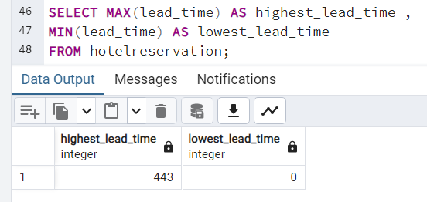
What is the highest and lowest lead time for reservations?
The highest lead time is 443 and the Lowest lead time is 0.

Slide 17
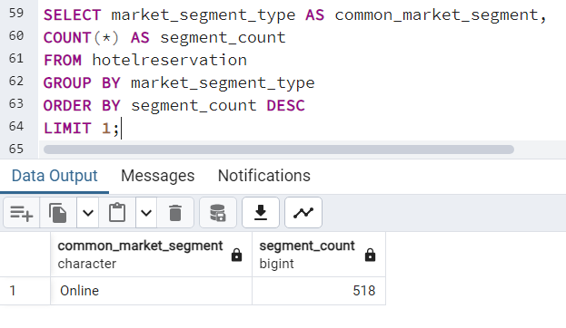
What is the most common market segment type for reservations?
Online is the highest common market segment type for reservation

Slide 18
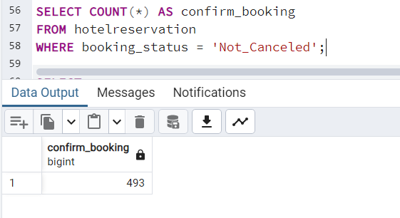
How many reservations have a booking status of "Confirmed"?
There is a “493” reservation have booking status of “Confirmed”

Slide 19
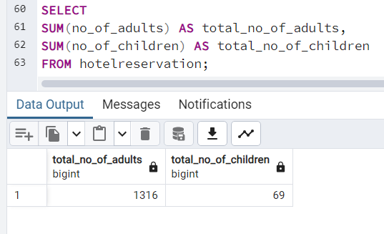
What is the total number of adults and children across all reservations?
The total number of adults is 1316 and the total no of children across all reservations is 69.

Slide 20
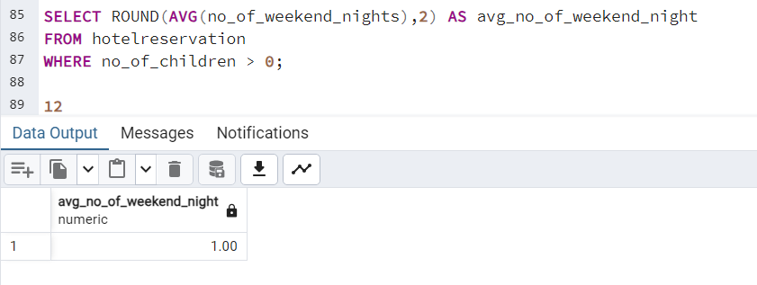
What is the average number of weekend nights for reservations involving children?
The average number of weekend nights for reservations involving children is 1.

Slide 21
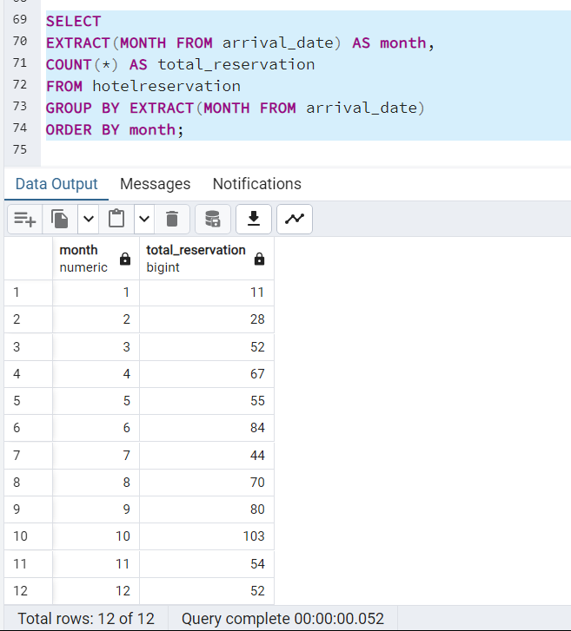
How many reservations were made in each month of the year?

Slide 22
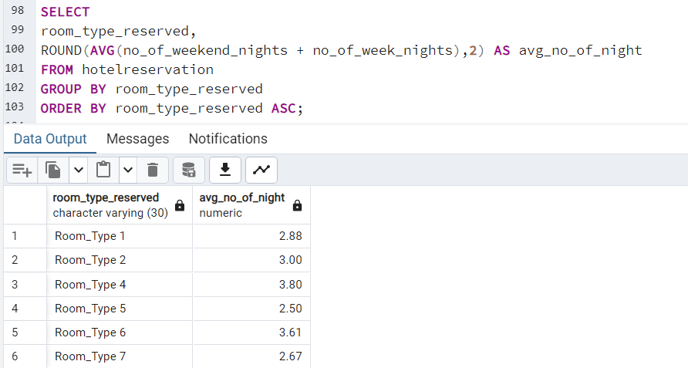
What is the average number of nights (both weekend and weekday) spent by guests for each room type?

Slide 23
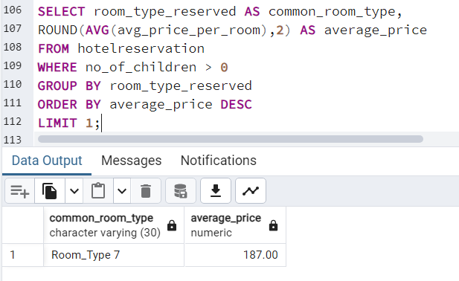
For reservations involving children, what is the most common room type, and what is the average price for that room type?
For reservations involving children, the most common room type is Room_type 7 and the average price for that room type is 187 RS.

Slide 24
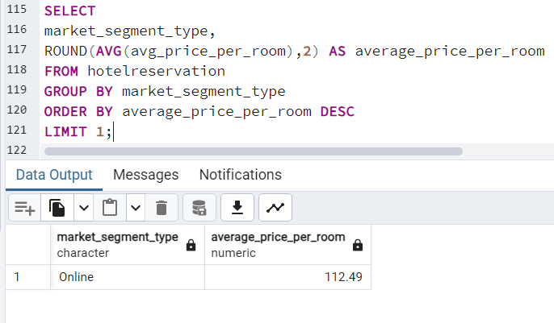
Find the market segment type that generates the highest average price per room.
The Market segment type that generates the highest average price per room is “Online” and the price is 112.49.

Slide 25

THANK YOU..

